Slide 1

Component 1 Update
Lori Eckhardt, PhD
Brown Spot Needle Blight Workshop
Auburn University
2-3 August 2023
Forest Health Dynamics Laboratory
College of Forestry, Wildlife and Environment – Auburn University

Slide 2
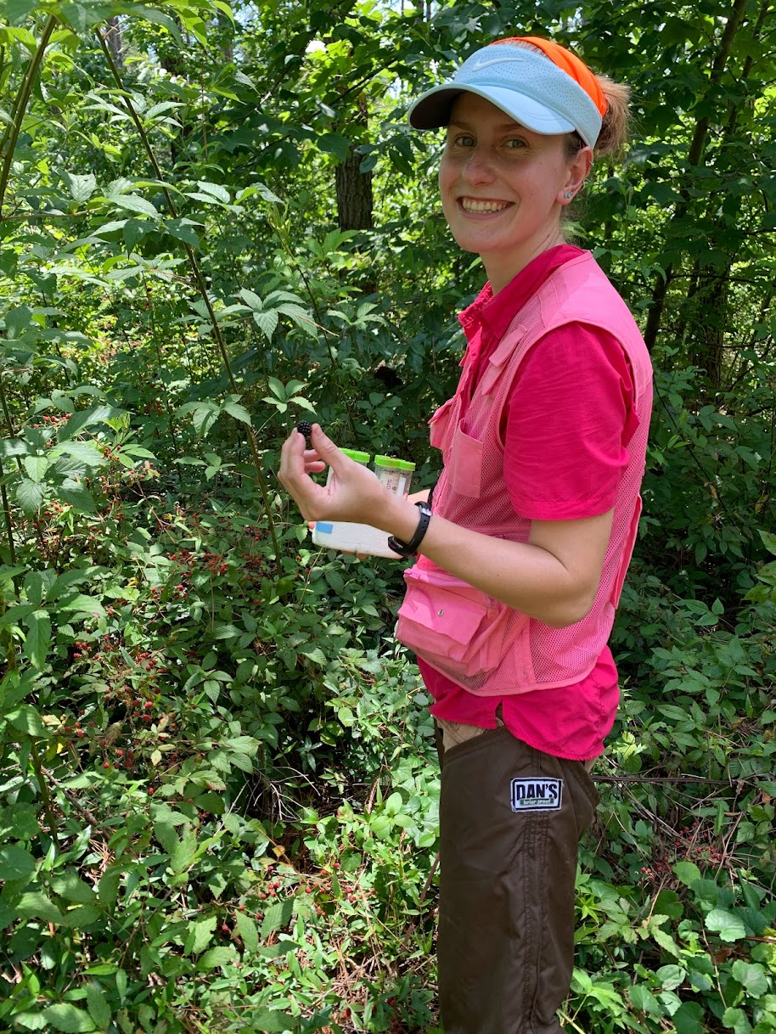
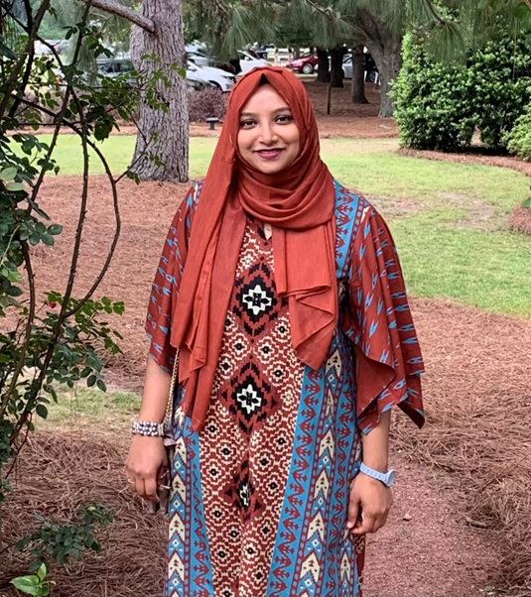
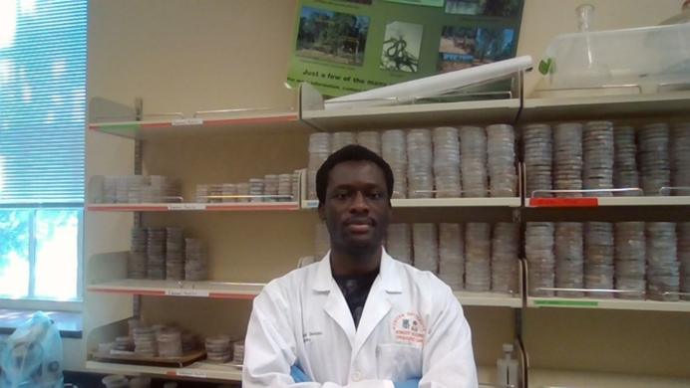
Forest Health Dynamics Lab Team
Forest Health Dynamics Laboratory
Graduate Students
Emmanuel Nyarko
MS Student
Jaden King
Ph.D. Student
Sharmin Toa
Ph.D. Student
College of Forestry, Wildlife and Environment – Auburn University

Slide 3
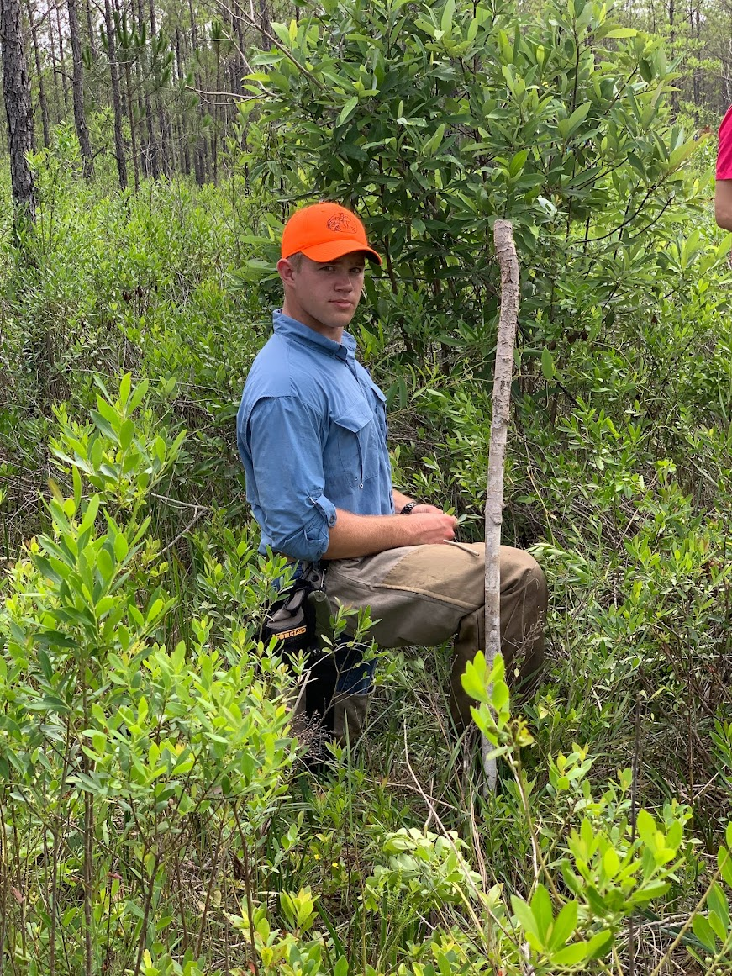
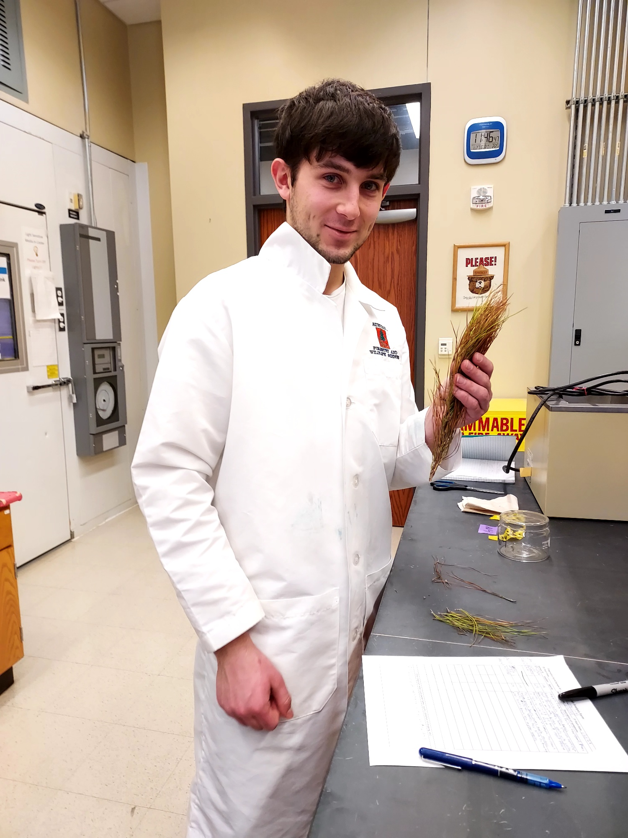
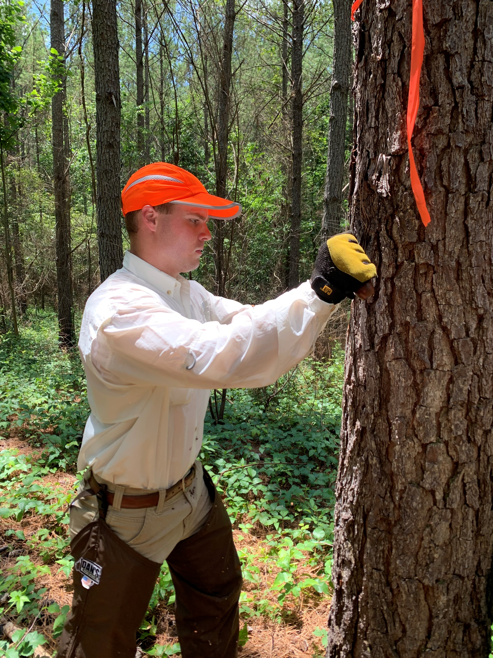
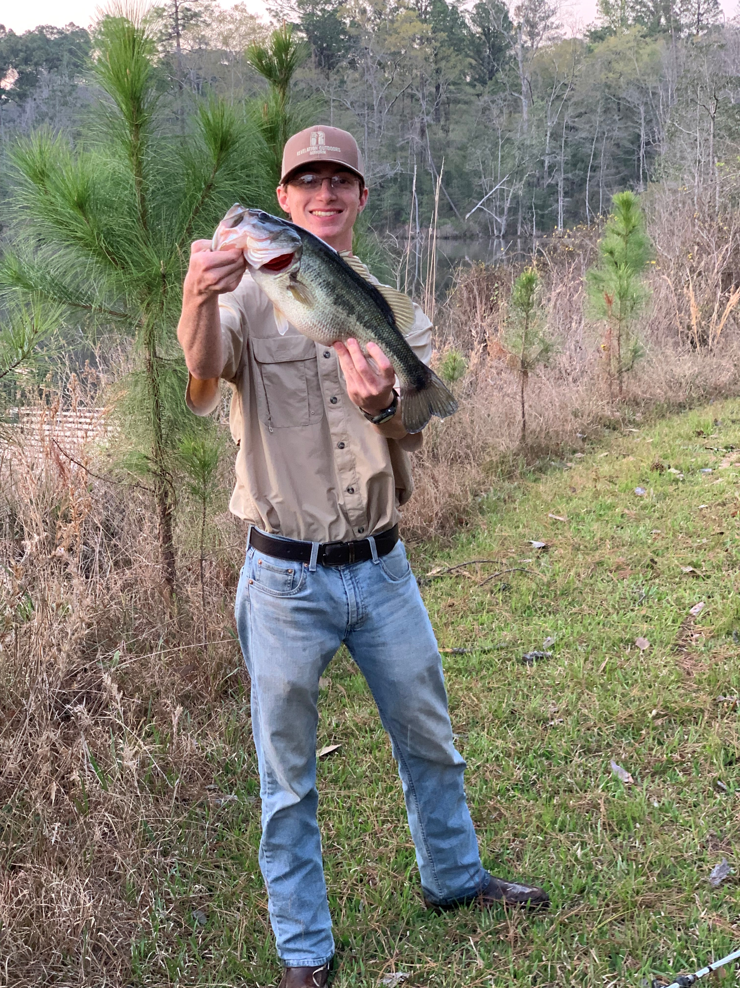
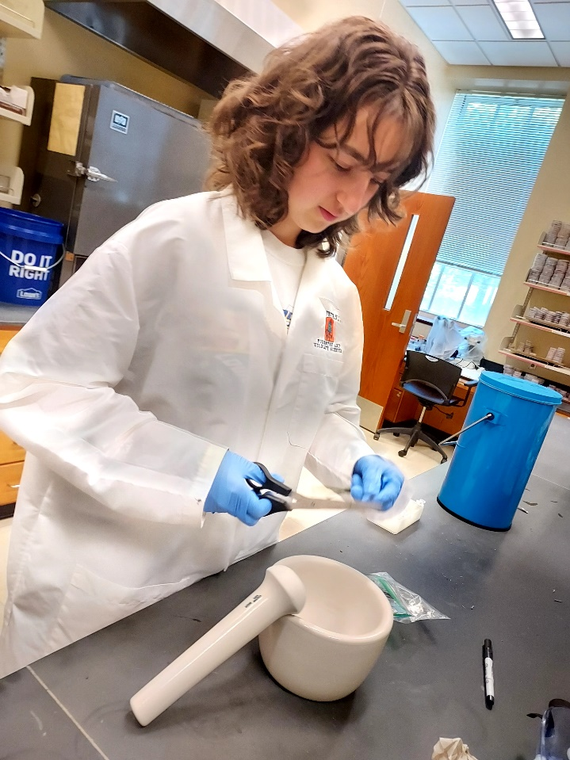
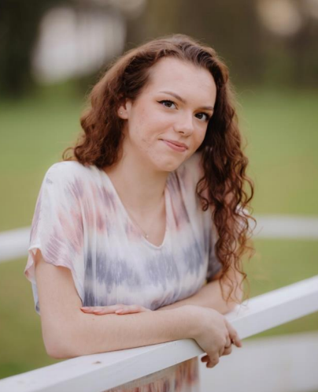
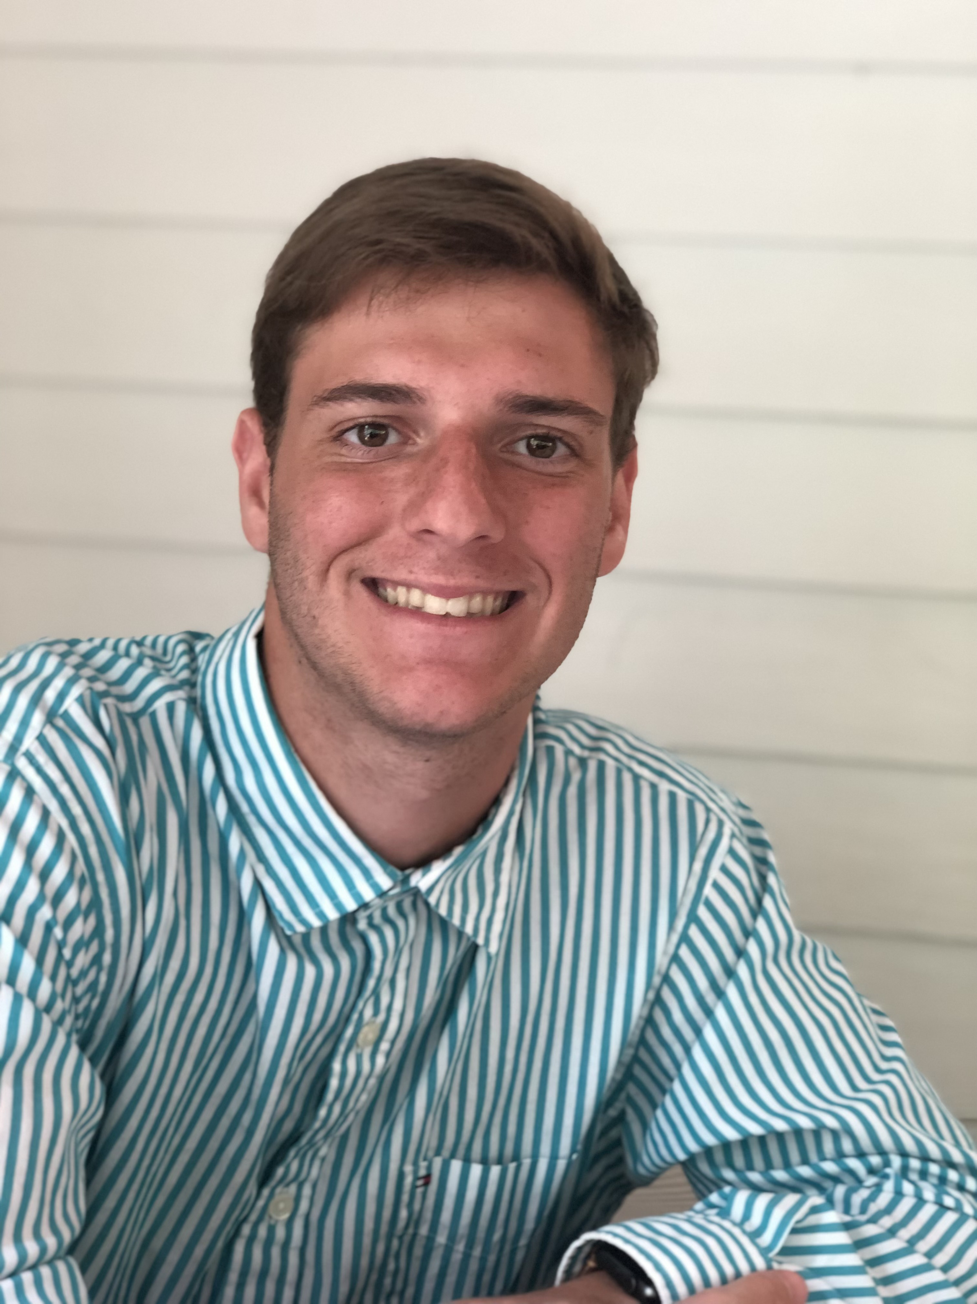
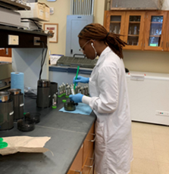
Forest Health Dynamics Lab Team
Forest Health Dynamics Laboratory
Undergraduate Students
Maddox Golden
UG Research Assistant
Gavin Kerr
UG Research Assistant
Drew Conway
UG Research Assistant
Andrew Howard
UG Research Assistant
Brea Thomas
Summer Intern
Gracey Goldsby
UG Research Assistant
Alexandra Foreman
UG Research Assistant
Garrett Gaar
Summer Intern
College of Forestry, Wildlife and Environment – Auburn University

Slide 4
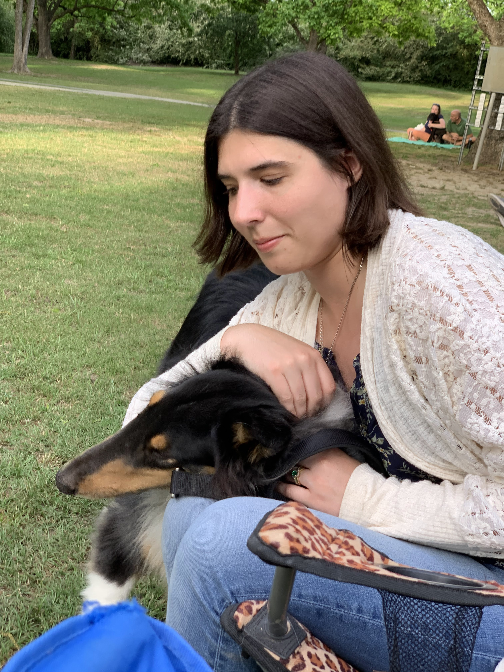
Forest Health Dynamics Lab Team
Forest Health Dynamics Laboratory
College of Forestry, Wildlife and Environment – Auburn University

Slide 5
Component 1
Forest Health Dynamics Laboratory
Inoculation protocol development for Lecanosticta acicola to develop a screening method to complete Koch’s postulates, determine strain aggressiveness and seedling tolerance
Main Objectives:
  Fungal pathogen isolation and identification
  Propagation of L. acicola
  Inoculation Study
College of Forestry, Wildlife and Environment – Auburn University

Slide 6
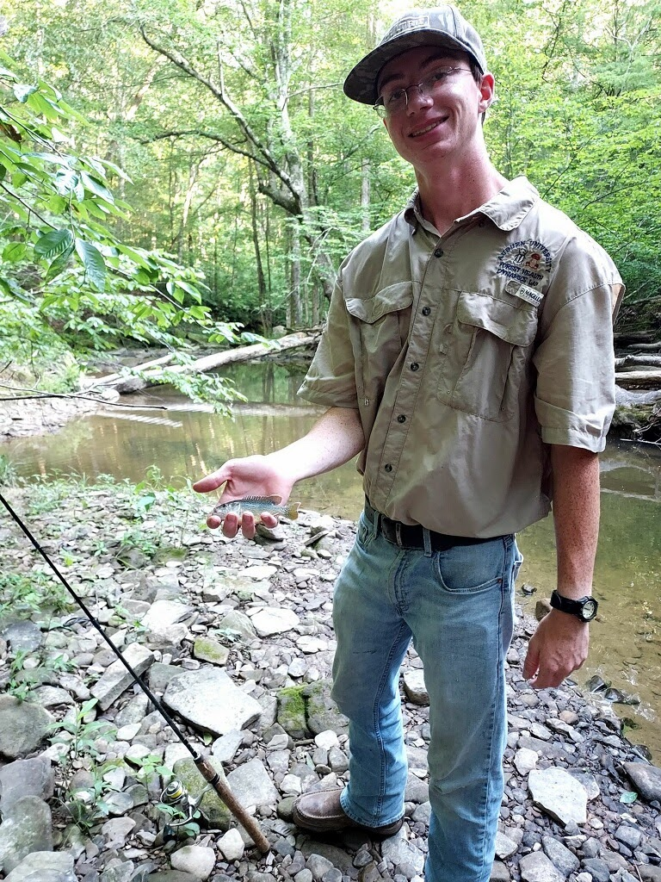
Component 1
Forest Health Dynamics Laboratory
Inoculation protocol development for Lecanosticta acicola to develop a screening method to complete Koch’s postulates, determine strain aggressiveness and seedling tolerance
Presenting Team:
Andrew Howard
UG Research Assistant
Emmanuel Nyarko
MS Student
College of Forestry, Wildlife and Environment – Auburn University

Slide 7
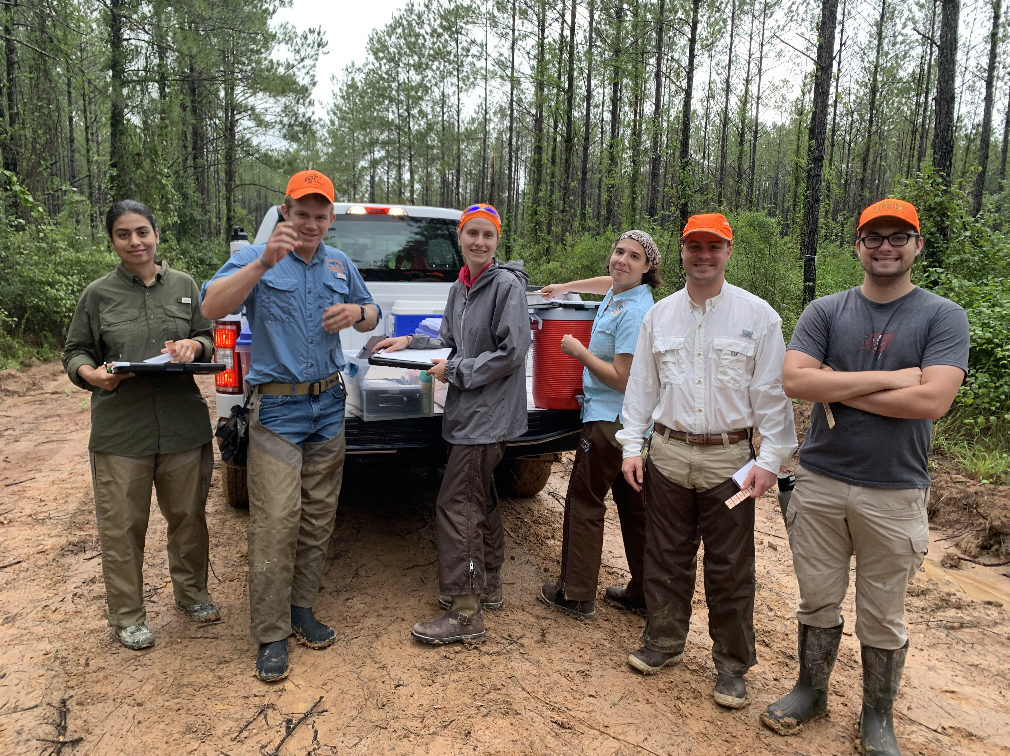
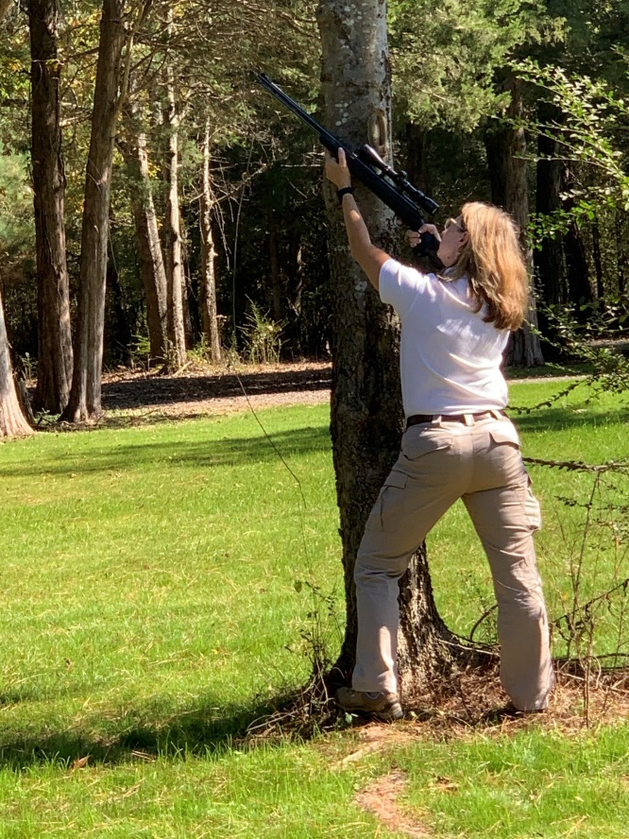
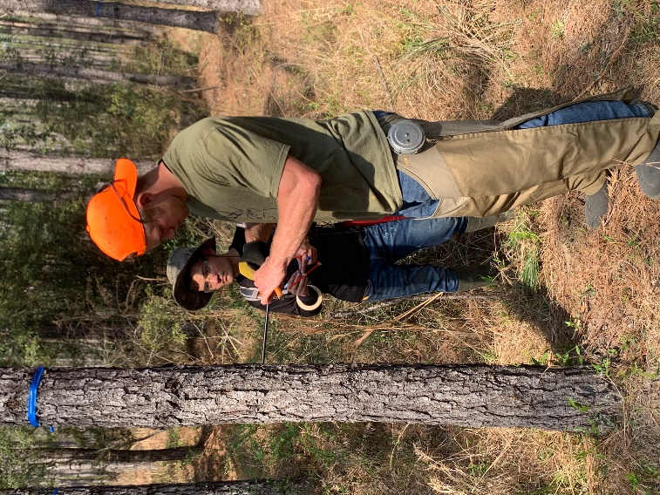
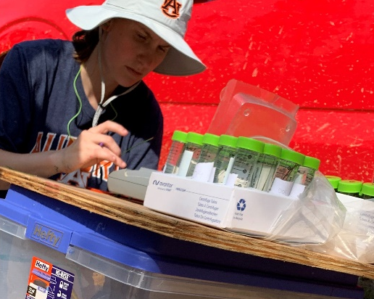
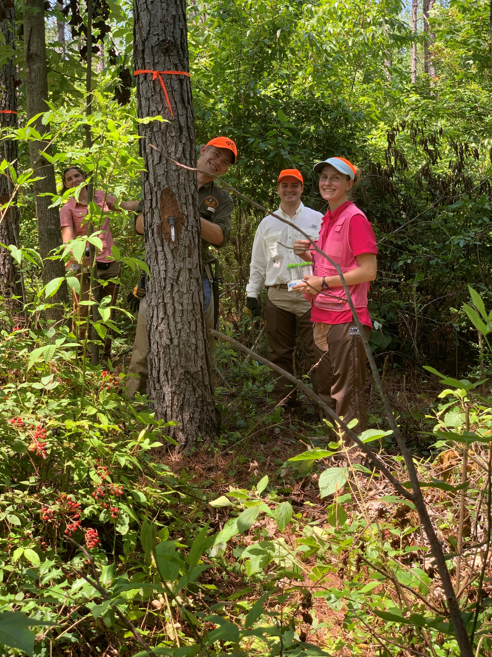
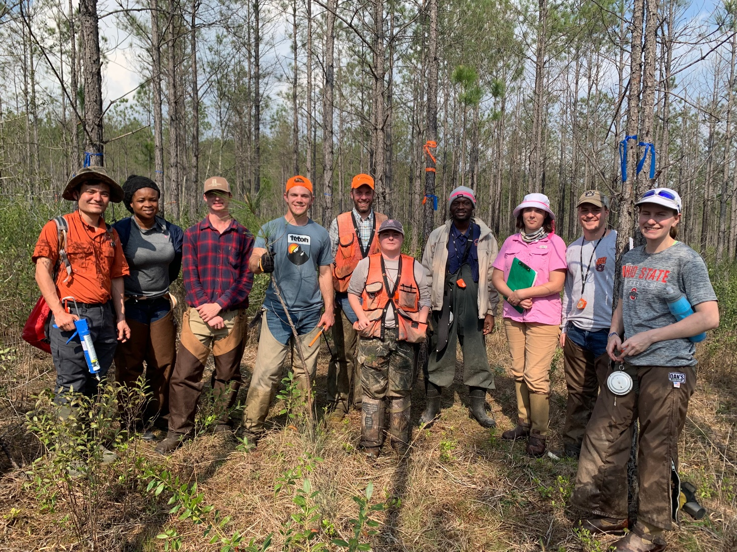
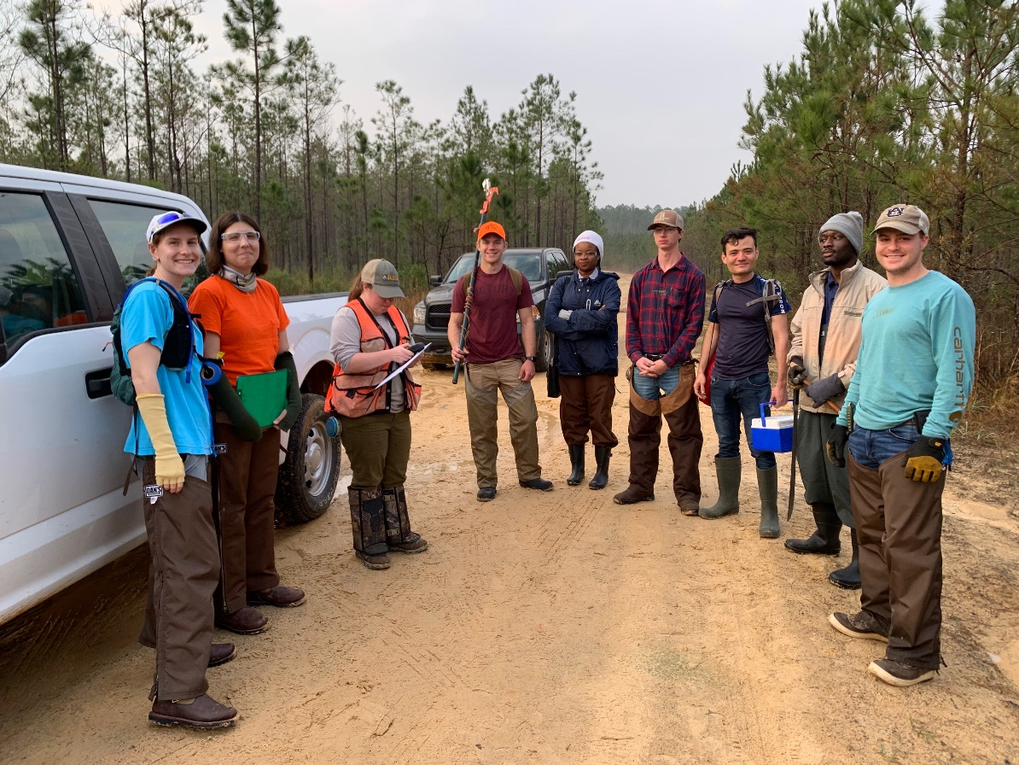
WORKING TO KEEP FORESTS HEALTHY
Forest Health Dynamics Laboratory
College of Forestry, Wildlife and Environment – Auburn University

